Slide 1

Microgoals: Secure Goal Management Backend API
An efficient and secure solution for modern goal tracking.
Team Members: Priya Bharathi P, Harini S, Mohanapriya S, Selvi G, Uzma Fahreen J
Arulmigu Kapaleeswarar Arts and Science College

Slide 2

Introduction
The Microgoals API is designed to simplify how individuals and teams track their objectives. By providing a structured, secure backend, we enable seamless integration for front-end applications, ensuring that goal management is both persistent and reliable.

Slide 3

Problem Statement
Managing personal and professional goals often becomes disorganized due to fragmented tools. Existing systems frequently lack a robust, scalable backend, leading to issues with data synchronization, security vulnerabilities, and difficulty in tracking progress over long durations.

Slide 4

Project Objectives
API
Goals
Develop secure RESTful endpoints
Enable CRUD operations for goals
Auth
DB
Implement robust user authentication
Optimize database performance

Slide 5





Technology Stack
Node.js
Express.js
High-performance JavaScript runtime.
Flexible web application framework.
MongoDB
VS Code
Scalable NoSQL document database.
Streamlined development environment.

Slide 6
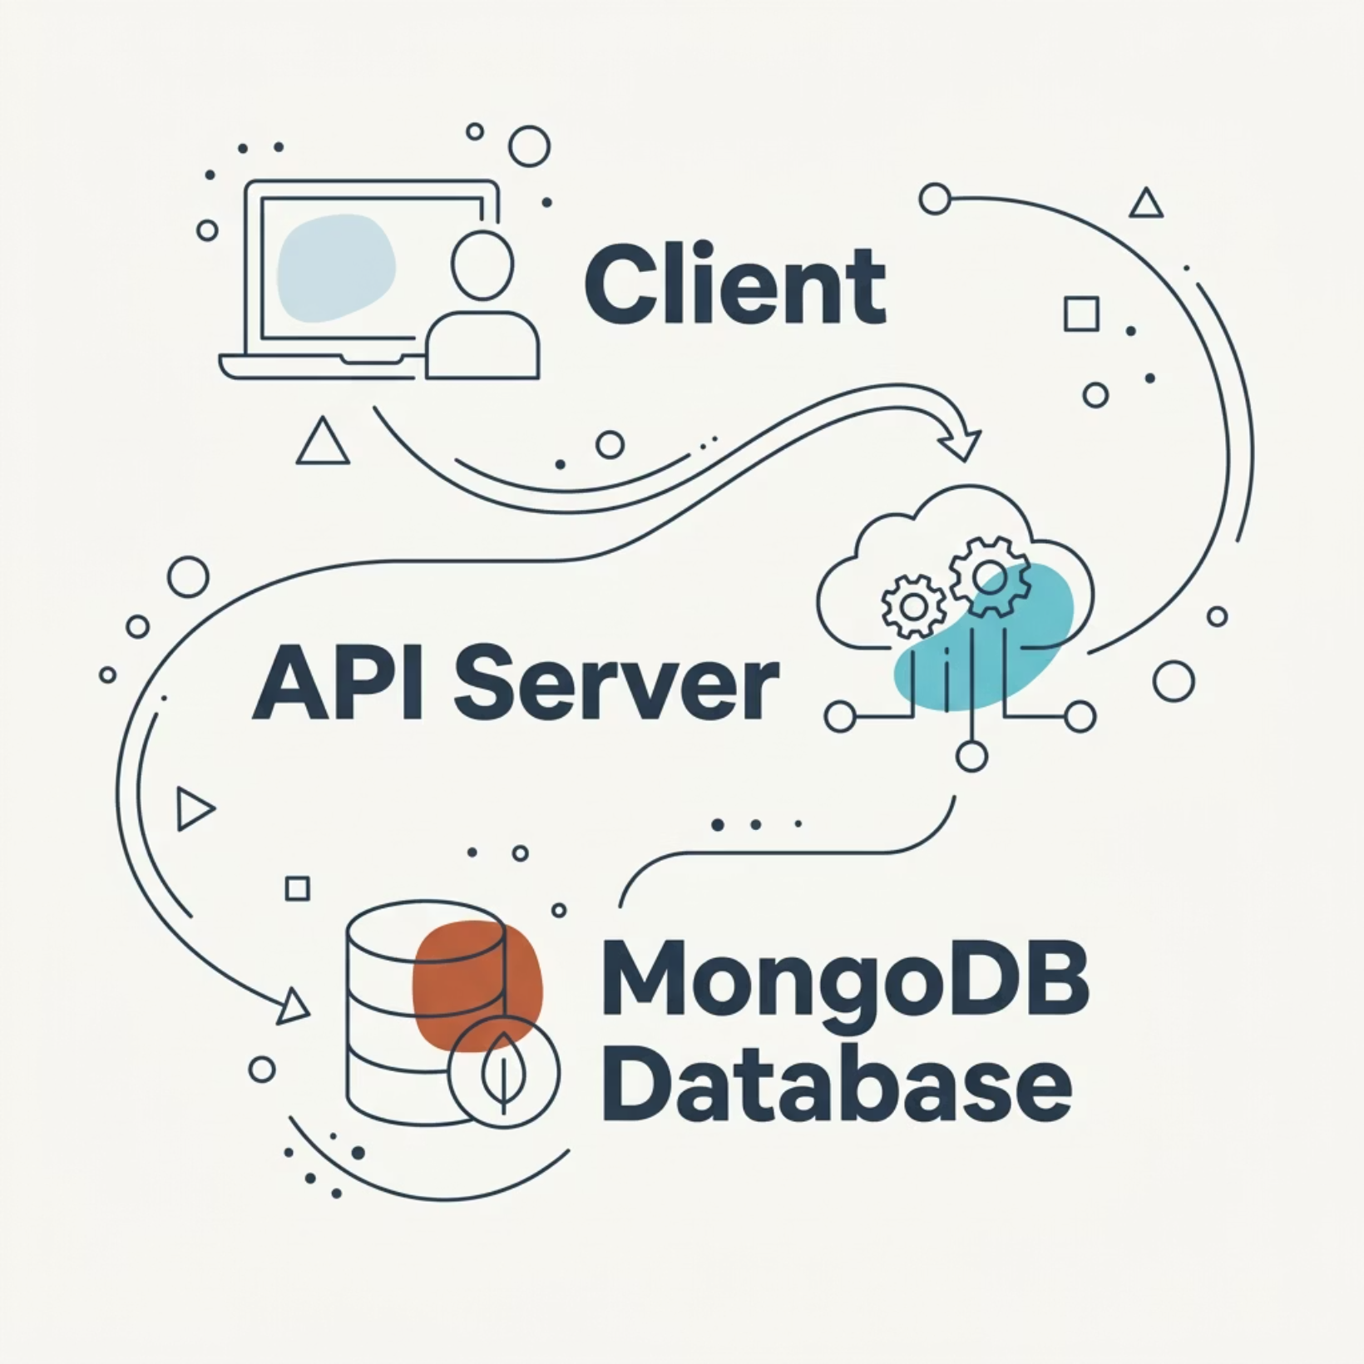

System Architecture
Our architecture follows a layered approach: The Client sends requests to the Express.js middleware, which handles authentication and validation before interacting with the MongoDB database to persist goal-related data.

Slide 7
Key Features
JWT Authentication
Dynamic Goal Creation
Progress Analytics
Secure user sessions and protected API routes.
Create, update, and track milestones with ease.
Real-time updates on task completion percentages.

Slide 8
API Endpoints
Method
Endpoint Description
POST
/auth/register - Create new user account
POST
/goals/add - Save a new goal milestone
GET
/goals/list - Retrieve all goals for a user
PUT
/goals/update/:id - Modify existing progress

Slide 9

Advantages
Low latency response times
High scalability for growing data
RESTful standards for easy integration
Simplified maintenance and deployment

Slide 10

Conclusion
The Microgoals API successfully bridges the gap between complex goal tracking needs and efficient backend execution. By leveraging a robust stack, we have created a scalable foundation for future developers to build upon, ensuring users reach their milestones faster and more securely.

